Slide 1

Orientation to Computing-I
L T P :2 0 0
www.lpu.in Lovely Professional University

Slide 2

Unit-5 (Moocs/Hackathons)
Introduction to MOOCs/Hackathons
MOOCs types, platforms, benefits
Globally recognized hackathons/competitions
MAANG companies.
www.lpu.in Lovely Professional University

Slide 3
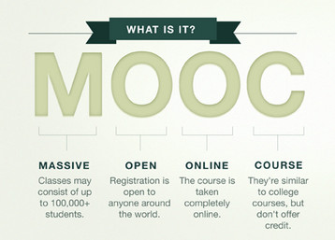
What is a MOOCs?
A course of study made available over the internet without charge to a very large number of people. "anyone who decides to take a MOOC simply logs on to the website and signs up"
www.lpu.in Lovely Professional University

Slide 4
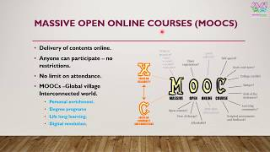
Types of MOOCs?
Proctored
Non-Proctored
www.lpu.in Lovely Professional University

Slide 5

MOOCs Platforms
, etc.
www.lpu.in Lovely Professional University

Slide 6
MOOCs Platforms
What are the best MOOC platforms to take online courses?
Swayam
Edx
Coursera, Udemy,
simplilearn Canvas Network.
iversity.
Cognitive Class.
Kadenze.
Coursera.
edX
Udacity
www.lpu.in Lovely Professional University

Slide 7
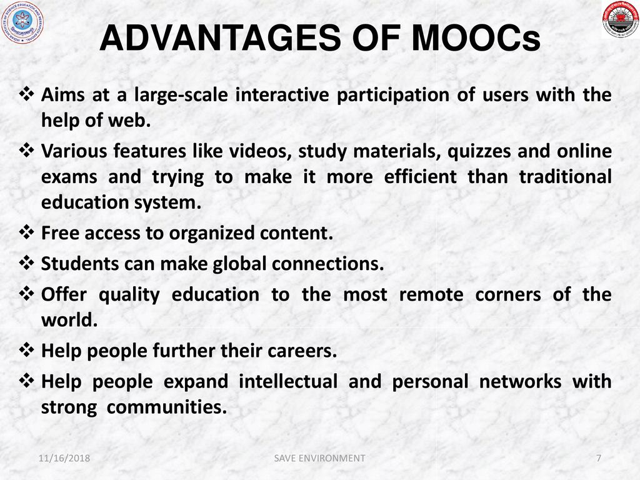
www.lpu.in Lovely Professional University

Slide 8
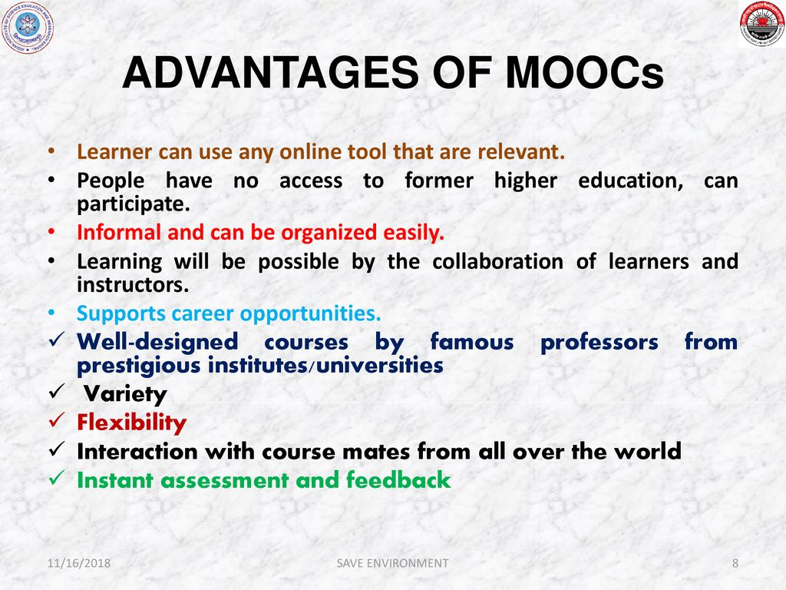
www.lpu.in Lovely Professional University

Slide 9
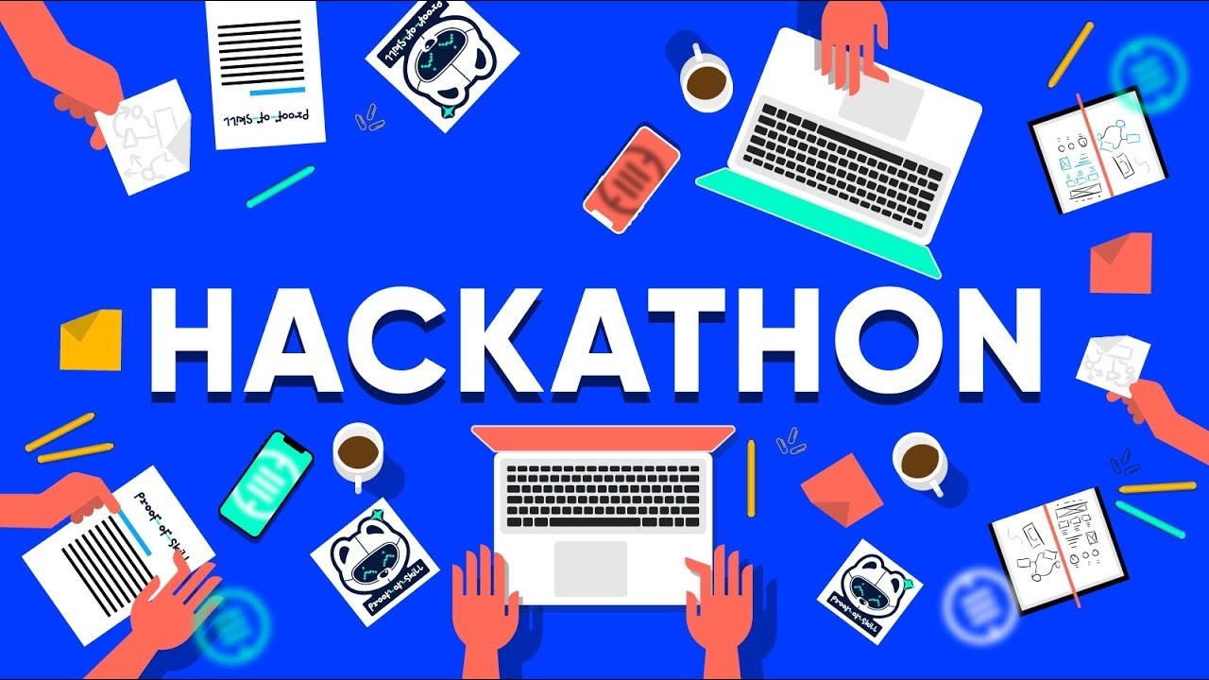
What is a Hackathon?
A hackathon is a design sprint-like event, in which often computer programmers and others involved in software development, including graphic designers, interface designers, product managers, project managers, domain experts, and others collaborate intensively on software projects
www.lpu.in Lovely Professional University

Slide 10
Advantages of Hackathons
Building a community through networking
Job opportunities
Certifications
Honing and learning skills
Innovative solutions to existing problems
www.lpu.in Lovely Professional University

Slide 11
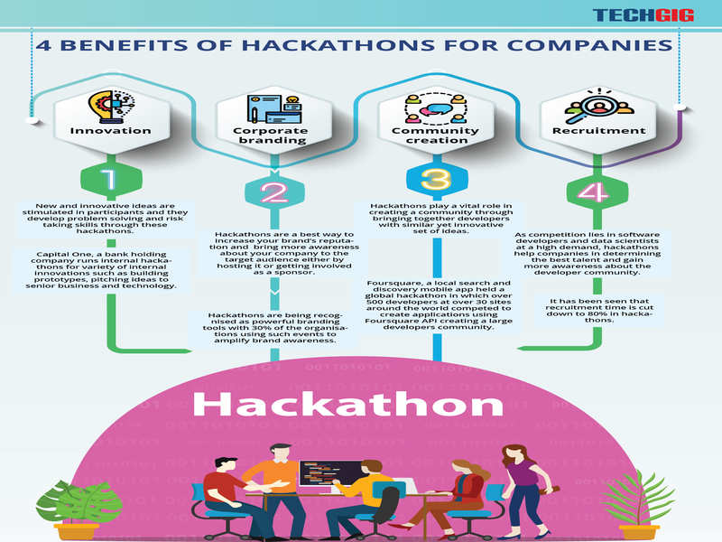
www.lpu.in Lovely Professional University

Slide 12
Hackathon Listings
Smart India Hackathon by AICTE and MHRD
Hackathon series by Facebook
The Great Indian Alexa Hackathon by Amazon
The Babylon Project by World Blockchain Hackathon
Angel Global Series Hackathon by AngelHack
College level hackathons
HackerRamp by Myntra
Code Gladiators by TechGig
www.lpu.in Lovely Professional University

Slide 13


MAANG?
MAANG is an acronym referring to the stocks of the five most popular and best-performing American technology companies.
These are: Meta (formerly known as Facebook); Amazon; Apple; Netflix; and Alphabet (formerly known as Google).
www.lpu.in Lovely Professional University

